Slide 1

Standards Based Grading
2018 AWSA Conference
Larry Zeman
Chetek-Weyerhaeuser Middle School/High School

Slide 2
Chetek-Weyerhaeuser???
Chetek and Weyerhaeuser Consolidated in 2010.
Rural District
Small (under 1000) School District
Large Geographic Area
High Property Value District
Low State Aid District
High Poverty County
45% - 52% Free and Reduced
Progressive School District
Follow Research
Learning Focused

Slide 4
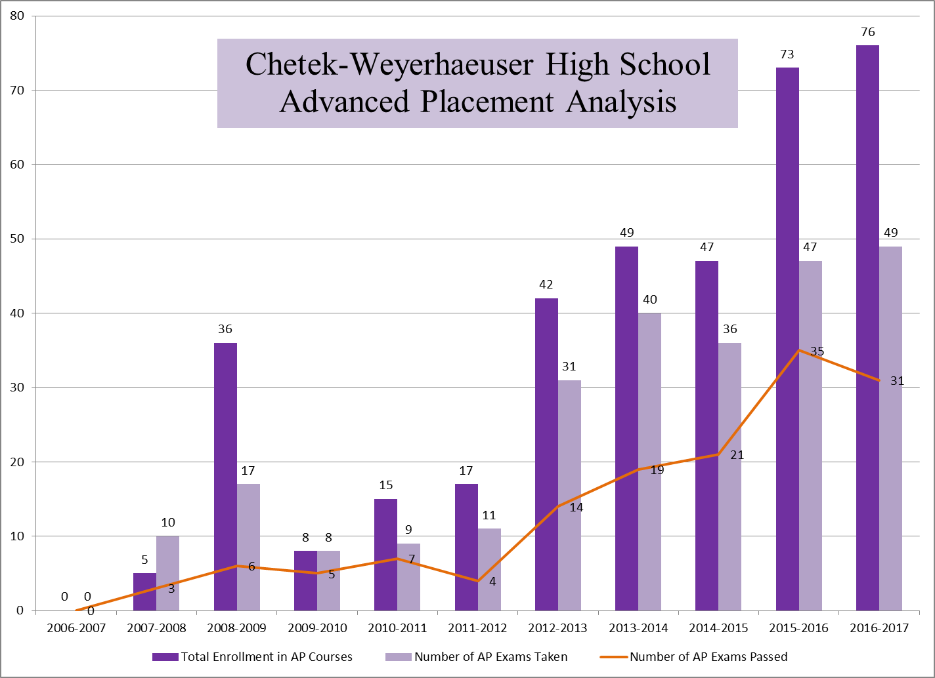

Slide 5
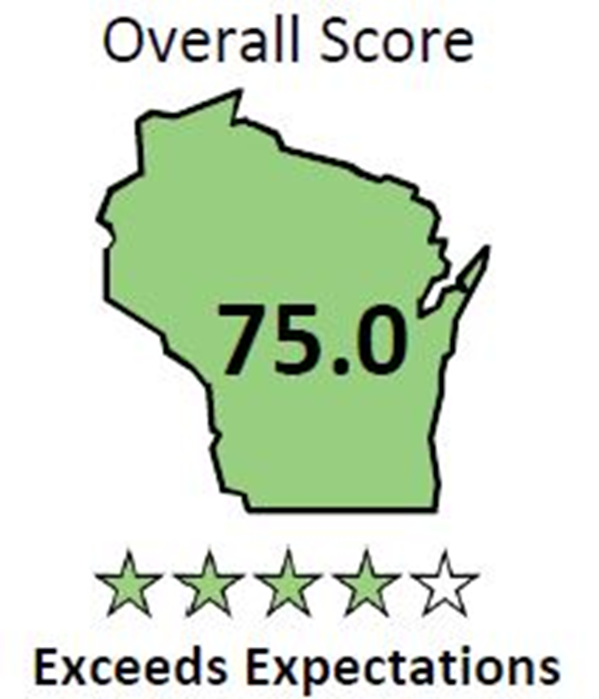
Chetek-Weyerhaeuser HS

Slide 6
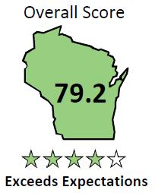
Chetek-Weyerhaeuser MS

Slide 7
4 BIG IDEAS
What do we want students to know and be able to do?
How will we know if they know it?
What will we do if they do not know it?
What will we do if they already know it?

Slide 8

Big Idea #1
What do we want students to know and be able to do?

Slide 9
Standards Based Grading
What is Standards Based Grading?
  Clearly stating what students are expected to know and be able to do and then providing students with feedback on their progress towards that goal.

Slide 10
Standards Based Grading
Learning Targets
  Chetek-Weyerhaeuser Curriculum
  http://www.cwasd.k12.wi.us/highschool/CWASDHSCurriculum.cfm

Slide 11
Big Idea #2
How will we know if they know it?

Slide 12
Standards Based Grading
Grading Policies
  Include only academic achievement in grades.
  Provide support for learning. Do not reduce scores on late work.
  Do not give points for extra credit work or use bonus points.
  Do not consider attendance in grades.
  Use only individual achievement evidence.
  Resist averaging grades.
  Allow students to reassess at any time.
  Emphasize recent achievement. Do not grade practice.
  Involve students in the grading process.

Slide 13
Standards Based Grading
Formative and Summative Assessments
  Answer to question #2 – How do we know if they learned it.
  Formative Assessment – Should inform the teacher and the student AND should be a learning experience.
  Summative Assessment – Final measure of learning. Not time dependent. Learning is the constant and time is the variable instead of learning the variable and time the constant.

Slide 14
Proficiency Table
4 Proficient Student demonstrates mastery of grade-level skills and processes with no major errors or omissions.
3 Developing Student demonstrates partial mastery of grade-level skills and processes.
2 Basic Student demonstrates mastery of all basic skills and processes but requires help to successfully complete higher-level skills and processes.
1 Minimal Student requires help to partially complete grade-level skills and processes.
0 No Evidence There is not sufficient evidence to assess student progress

Slide 15
Grade Mark Entries
Overall Proficiency Score | Average Range | Skyward Percentages (Grade Mark Entries)
4 | 3.75 – 4.00 | 93.75 – 100
3.5 | 3.25 – 3.74 | 81.25 – 93.74
3 | 2.75 – 3.24 | 68.75 – 81.24
2.5 | 2.25 – 2.74 | 56.25 – 68.74
2 | 1.75 – 2.24 | 43.75 – 56.24
1.5 | 1.25 – 1.74 | 31.25 – 43.74
1 | .75 – 1.24 | 18.75 – 31.24
.5 | .25 - .74 | 6.25 – 18.74
0 | 0 - .24 | 0 – 6.24

Slide 16
Average Proficiency to Grade to GPA Points Conversion Table This table provides a mapping from the averaged proficiency scores in the subject (unit) level into a grade for the class. This table also then provides a mapping for grades into GPA Points which are used to calculate student GPAs.
Averaged Proficiency Scale | Skyward Percentages (Grade Mark Entries) | Summary Grade Conversion | GPA Points
3.8-4.0 | 95.00 – 100 | A+ | 4
3.59-3.79 | 89.75 – 94.99 | A | 4
3.38-3.58 | 84.50 – 89.74 | A- | 3.67
3.17-3.37 | 79.25 – 84.49 | B+ | 3.33
2.96-3.16 | 74.00 – 79.24 | B | 3
2.75-2.95 | 68.75 – 73.99 | B- | 2.67
2.54-2.74 | 63.50 – 68.74 | C+ | 2.33
2.33-2.53 | 58.25 – 63.49 | C | 2
2.12-2.32 | 53.00 – 58.24 | C- | 1.67
1.91-2.11 | 47.75 – 52.99 | D+ | 1.33
1.7-1.9 | 42.50 – 47.74 | D | 1
1.49-1.69 | 37.25 – 42.49 | D- | .67
Below 1.49 | 0 – 37.24 | F | 0

Slide 17
Big Idea #3
What will we do if they do not know it?

Slide 18
Standards Based Grading
Interventions
  Three tier approach.
    Tier 1 – Classroom interventions.
    Tier 2 – System-wide intervention for students in need.
    Tier 3 – Intensive intervention in addition to grade level instruction for students significantly behind their peers.

Slide 19
Big Idea #4
What do we do if they already know it?

Slide 20
Standards Based Grading
Advanced Learner Opportunities
  Answer to question #4 – What do we do if they already know it?
    Middle School STELM
    Course Acceleration
    Grade Acceleration
    ECCP (Early College Credit Program)
    Advanced Placement

Slide 21

OK – OK Show an Example

Slide 22
Standards Based Report Card
Full Range of Report Card Options
  Class Grades Only
  Class Grades and Unit Grades
  Class Grades, Unit Grades, and Learning Target Grades
Last, but certainly not least – Family Access view
  Parent view in Family Access

Slide 23
Thank You - Questions?
Larry Zeman – lazeman@cwasd.k12.wi.us

